Slide 1
Identifying Synthetic Content
MASTER SLIDE DECK
For presentation
English
Spanish with details
This master slide deck is NOT used for presentation.
Notes:
Start by creating a slide master that is in English. As needed duplicate and translate slides into target language. Color English slides in Yellow and target language slides in white. The example below uses Spanish as a theoretical target language.

Slide 2
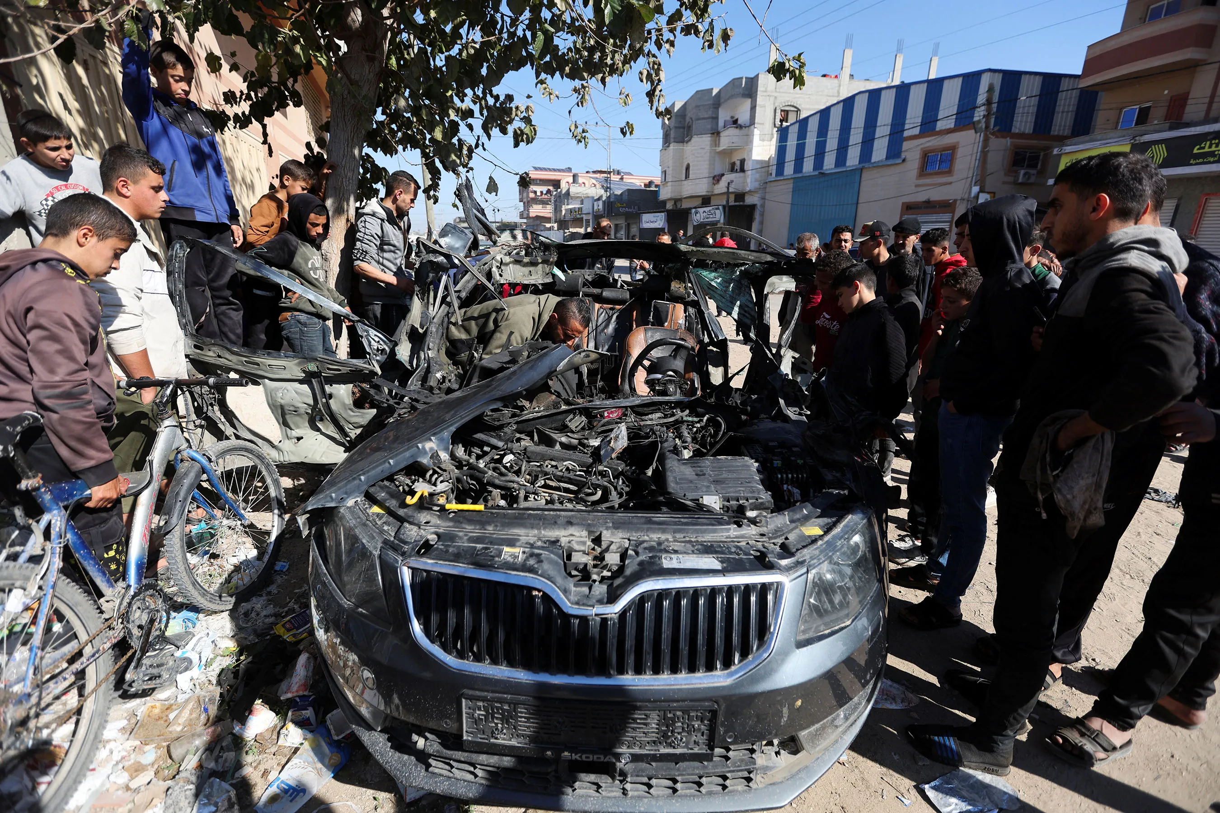
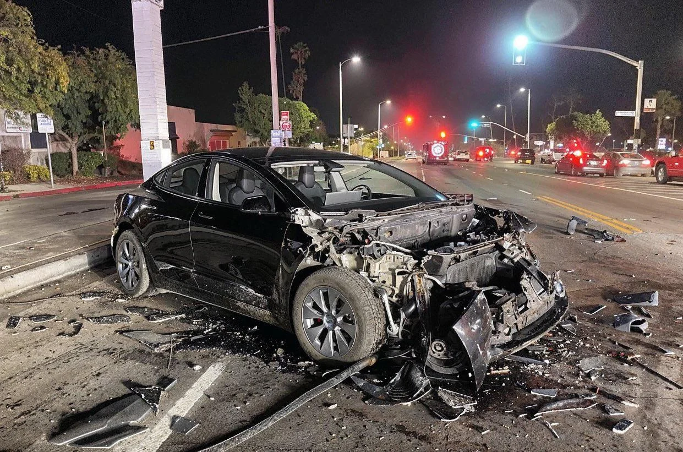
Which is Real?

Slide 3
¿Cual es real?

Slide 4


Which is Real?

Slide 5
¿Cual es real?

Slide 7
Identifying Synthetic Content
Notes:
Start by creating a slide master that is in English. As needed duplicate and translate slides into target language. Color English slides in Yellow and target language slides in white. The example below uses Spanish as a theoretical target language.

Slide 8
Identificación de Contenido Sintético
Notes:
Start by creating a slide master that is in English. As needed duplicate and translate slides into target language. Color English slides in Yellow and target language slides in white. The example below uses Spanish as a theoretical target language.

Slide 9
Lesson Objectives
Identify AI-generated content effectively using specific detection techniques for images, text, and audio.
References:
Media Lab at MIT on Detecting Fakes
Detect Fakes with Kellogg's online tool
CISA Contextualizing Deepfake Threats to Organizations
DARPA: Deepfake Defense Tech Ready for Commercialization, Transition

Slide 10
Objetivos de la Lección
Identifique contenido generado por IA de manera efectiva utilizando técnicas de detección específicas para imágenes, texto y audio.
Referencias:
Media Lab at MIT on Detecting Fakes
Detect Fakes with Kellogg's online tool
CISA Contextualizing Deepfake Threats to Organizations
DARPA: Deepfake Defense Tech Ready for Commercialization, Transition

Slide 11
Synthetic Check: Human Image
Context of the scene
Hands and limbs of people
Face and facial features
Clothes and items

Slide 12
Proceso de detección sintética: Imagen Humana
Contexto de la escena
Manos y extremidades de personas
Rostro y rasgos faciales.
Ropa y artículos

Slide 13
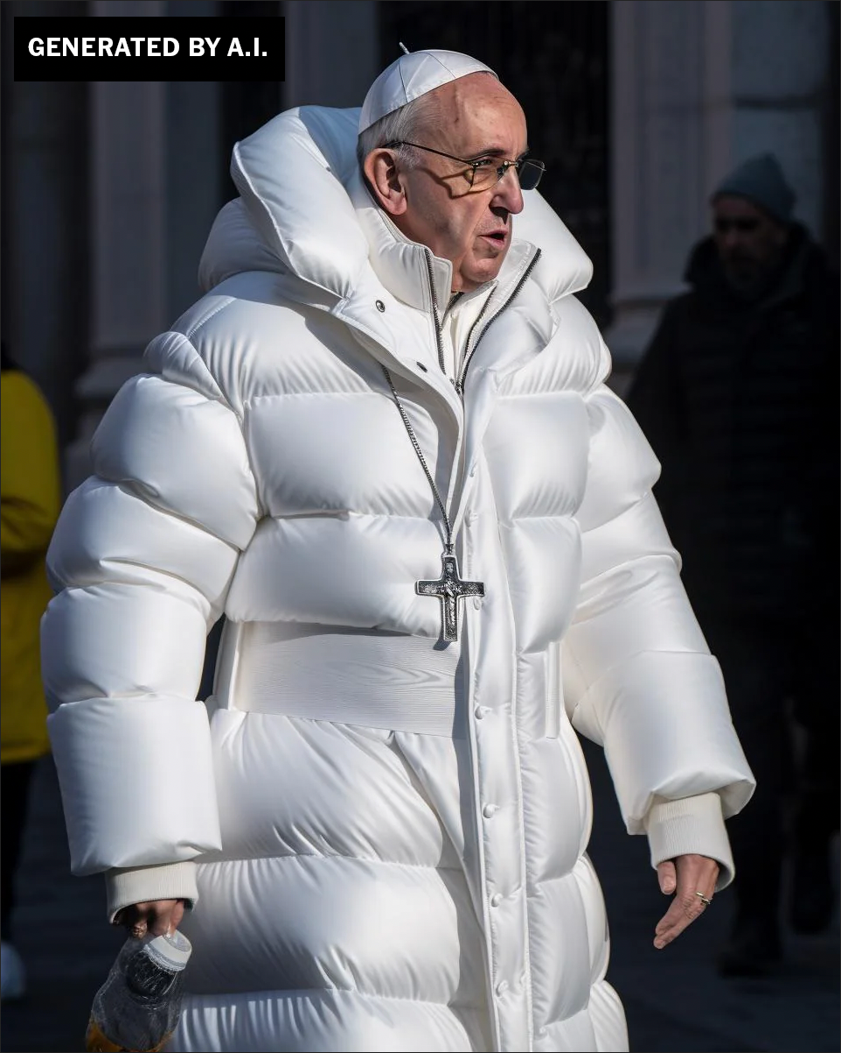
Human Images

Slide 14
Imagen Humana
¿Qué notas?

Slide 15
Human Images: Context
Logic and Context of the Scene

Slide 16
Imagen Humana: Context
Contexto de la escena

Slide 17
Human Images: Hands and Limbs
Pay Attention to the Hands and Fingers

Slide 18
Imagen Humana : Hands and Limbs
Manos y extremidades de personas

Slide 19
Human Images: Face
Pay Attention to the Face
Pay attention to the cheeks and forehead
Pay attention to the eyes and eyebrows
Pay attention to the glasses
Pay attention to facial hair
Pay attention to facial moles

Slide 20
Human Images: Face
Presta atención a la cara
Presta atención a las mejillas y la frente.
Presta atención a los ojos y las cejas.
Presta atención a las gafas.
Presta atención al vello facial
Presta atención a los lunares faciales.

Slide 21
Human Images: Clothing
Pay attention to the clothes
Warped Items
Missing and Extra items
Perspective and Geometry
Repetition in Detail
Material Texture

Slide 22
Human Images: Clothing
Presta atención a la ropa.
Artículos deformados
Artículos faltantes y adicionales
Perspectiva y Geometría
Repetición en detalle
Textura del material

Slide 23
Human Image Check
Context of the scene
Hands and limbs of people
Face and facial features
Clothes and items

Slide 24
Proceso de detección sintética: Imagen Humana
Context of the scene
Hands and limbs of people
Face and facial features
Clothes and items

Slide 25
Human Image Check
Context of the scene
Hands and limbs of people
Face and facial features
Clothes and items

Slide 26
Proceso de detección sintética: Imagen Humana
Contexto de la escena
Manos y extremidades de personas
Rostro y rasgos faciales.
Ropa y artículos

Slide 27

Human Images: Check On Learning
What do you notice?

Slide 28
Proceso de detección sintética: Imagen Humana: Practica
¿Qué notas?

Slide 29

Human Images: Check On Learning
What do you notice?

Slide 30
Proceso de detección sintética: Imagen Humana: Practica
¿Qué notas?

Slide 31
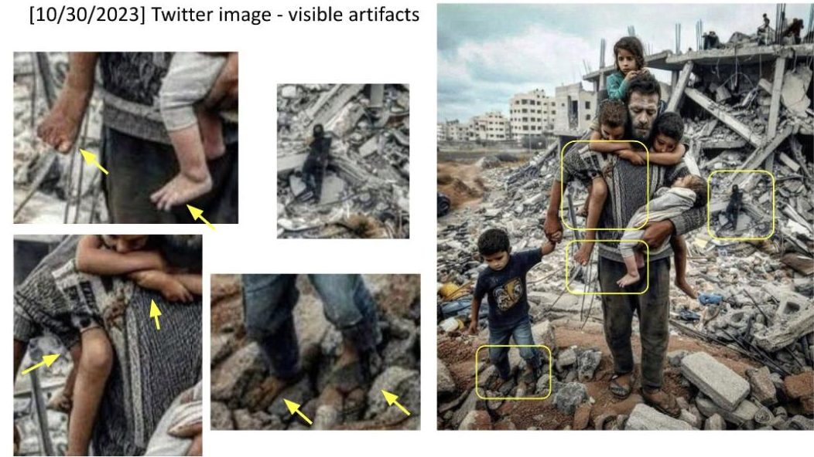

Slide 32
Structure Image Check
Context of the scene
Structural Consistency
Material Texture
Lighting and Shadows
Perspective and Geometry
Repetition in Detail
Missing Elements
Nonsensical Object Placement
Disrupted Continuity
Anomalies in Common Patterns

Slide 33
Proceso de detección sintética: Structuras
Contexto de la escena
Consistencia estructural
Textura del material
Iluminación y sombras
Perspectiva y Geometría
Repetición en detalle
Elementos faltantes
Colocación de objetos sin sentido
Continuidad interrumpida
Anomalías en patrones comunes

Slide 34
Structure Image
What do you notice?

Slide 35
Imagen de una escena
¿Qué notas?

Slide 36
Structure Image
Structural Consistency
Perspective and Geometry
Repetition in Detail
Nonsensical Object Placement
Anomalies in Common Patterns

Slide 37
Imagen de una escena
Consistencia estructural
Perspectiva y Geometría
Repetición en detalle
Colocación de objetos sin sentido
Anomalías en patrones communes

Slide 38
Structure Image
Structural Consistency
Perspective and Geometry
Repetition in Detail
Nonsensical Object Placement
Anomalies in Common Patterns

Slide 39
Imagen de una escena
Consistencia estructural
Perspectiva y Geometría
Repetición en detalle
Colocación de objetos sin sentido
Anomalías en patrones communes

Slide 40
Structure Image
Structural Consistency

Slide 41
Imagen de una escena
Consistencia estructural

Slide 42
Structure Image: Check On Learning
Context of the scene
Structural Consistency
Material Texture
Lighting and Shadows
Perspective and Geometry
Repetition in Detail
Missing Elements
Nonsensical Object Placement
Disrupted Continuity
Anomalies in Common Patterns

Slide 43
Proceso de detección sintética: Structuras
Context of the scene
Structural Consistency
Material Texture
Lighting and Shadows
Perspective and Geometry
Repetition in Detail
Missing Elements
Nonsensical Object Placement
Disrupted Continuity
Anomalies in Common Patterns

Slide 44
Structure Image Check
Context of the scene
Structural Consistency
Material Texture
Lighting and Shadows
Perspective and Geometry
Repetition in Detail
Missing Elements
Nonsensical Object Placement
Disrupted Continuity
Anomalies in Common Patterns

Slide 45
Proceso de detección sintética: Structuras
Contexto de la escena
Consistencia estructural
Textura del material
Iluminación y sombras
Perspectiva y Geometría
Repetición en detalle
Elementos faltantes
Colocación de objetos sin sentido
Continuidad interrumpida
Anomalías en patrones comunes

Slide 46
Synthetic Video Check
FIXME
Context of the scene
Structural Consistency
Material Texture
Lighting and Shadows
Perspective and Geometry
Repetition in Detail
Missing Elements
Nonsensical Object Placement
Disrupted Continuity
Anomalies in Common Patterns

Slide 47
References
1. Media Lab at MIT on Detecting Fakes - https://www.media.mit.edu/projects/detect-fakes/overview/
2. Detect Fakes with Kellogg's online tool - https://detectfakes.kellogg.northwestern.edu/
3. CISA Contextualizing Deepfake Threats to Organizations - https://media.defense.gov/2023/Sep/12/2003298925/-1/-1/0/CSI-DEEPFAKE-THREATS.PDF
4. DARPA: Deepfake Defense Tech Ready for Commercialization, Transition - https://www.darpa.mil/news-events/2024-03-14#:~:text=Through%20the%20Semantic%20Forensics%20

Slide 48
Referencias
1. Media Lab at MIT on Detecting Fakes - https://www.media.mit.edu/projects/detect-fakes/overview/
2. Detect Fakes with Kellogg's online tool - https://detectfakes.kellogg.northwestern.edu/
3. CISA Contextualizing Deepfake Threats to Organizations - https://media.defense.gov/2023/Sep/12/2003298925/-1/-1/0/CSI-DEEPFAKE-THREATS.PDF
4. DARPA: Deepfake Defense Tech Ready for Commercialization, Transition - https://www.darpa.mil/news-events/2024-03-14#:~:text=Through%20the%20Semantic%20Forensics%20

Slide 49

Why Does It Matter To You?

Slide 50
¿Por Qué Te Importa?

Slide 51

TAKE A BREAK
Return By: XX:XX

Slide 52
TOMAR UN DESCANSO
Volver por: XX:XX

